Slide 1


INSURANCE MANAGEMENT SYSTEM
22PMC154
SHONA C
Date:25/05/2023

Slide 2




INTRODUCTION
Insurance Management System offers a user-friendly interface for managing insurance categories, policies, and user interactions. It improves the efficiency of policy management, facilitates seamless user experiences, and enhances communication between users and administrators.

Slide 3

OVERVIEW
The Insurance Management System is a web-based application designed to streamline the process of managing insurance policies and provide an efficient platform for both administrators and users. The system aims to automate various tasks related to policy management, user interactions, and query handling.

Slide 4
PROJECT REQUIREMENTS
User Management
Insurance Category Management
Policy Management
Policy Selection
View Policy History
Query Handling
User-Friendly Interface

Slide 5
FEATURES AND HIGHLIGHTS
Insurance Category Management:
Administrators can manage insurance categories, including adding new categories, updating existing ones, and deleting categories as needed.
Policy Management:
Administrators have the ability to add new policies to the system.
Policies can be added with details such as policy name, coverage, premium amount, terms, and conditions.

Slide 6
3. Policy Selection:
Users can select policies.
4. Policy Users Application and Approval Process:
can apply for policies through the system.
Each policy application requires action from the administrator for approval or disapproval.
5. Query Handling:
Users can ask queries related to policies, claims, or any other insurance matters.
Administrators can manage and respond to user queries, providing timely and accurate information.

Slide 7
ARCHITECTURE
Backend Framework: Django (Python)
Relational Database Management System: SQLite
Frontend Technologies: HTML, CSS, and JavaScript
User Authentication and Authorization: Django's built-in authentication system can be utilized for user registration, login, and session management.

Slide 8
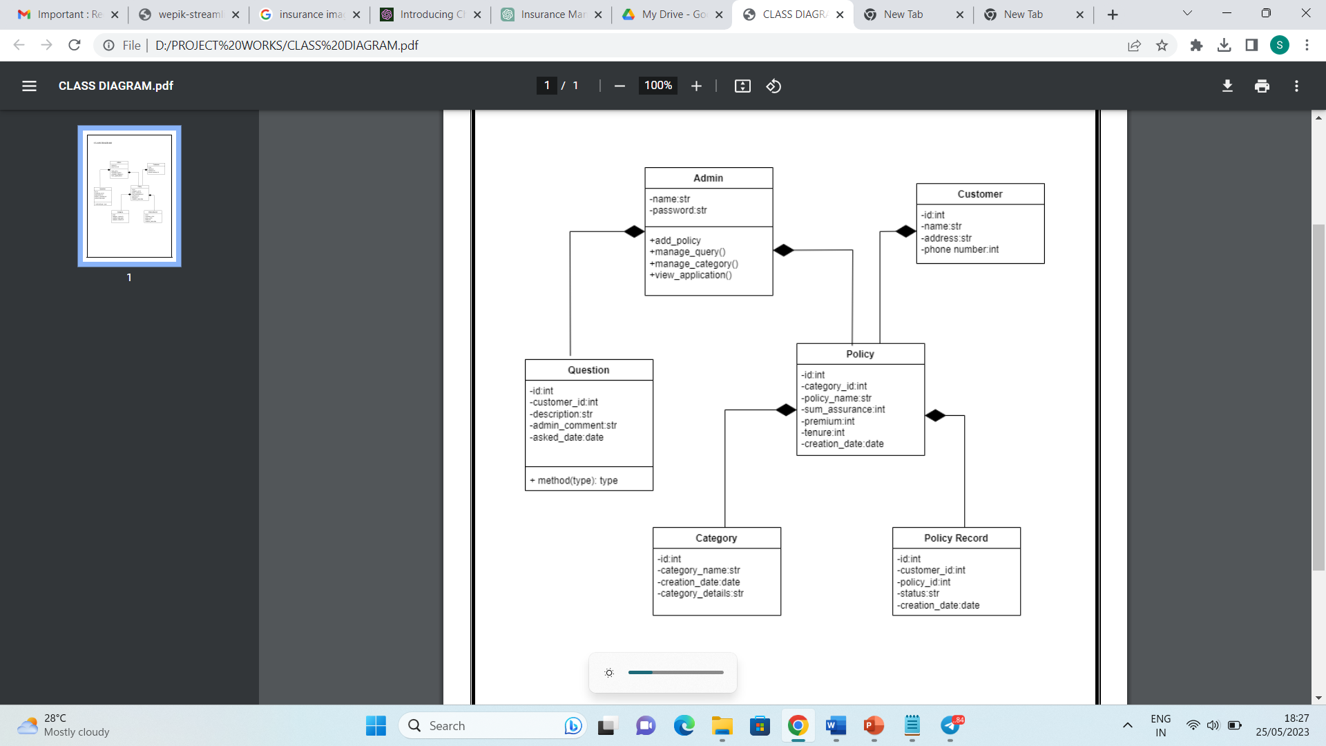
CLASS DIAGRAM

Slide 9

CHALLENGES FACED DURING DEVELOPMENT
Take time to thoroughly analyze the requirements of the project and create a detailed plan or flowchart that outlines the different steps and components involved. Break down the project into smaller tasks and prioritize them based on dependencies.
Refer to the Django documentation and tutorials specifically related to user authentication and registration. Understand the concepts of user models, forms, and views in Django.

Slide 10
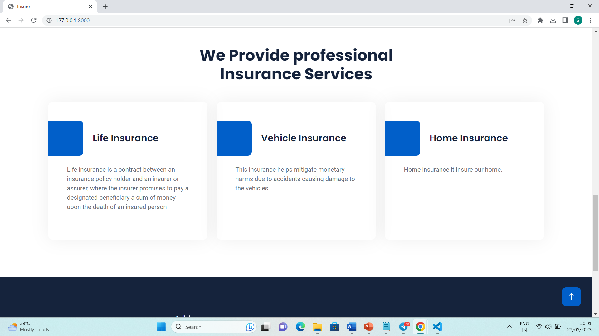
SCREENSHOTS
The home page is made dynamic by displaying the details of insurances from the Django admin site for the users.

Slide 11
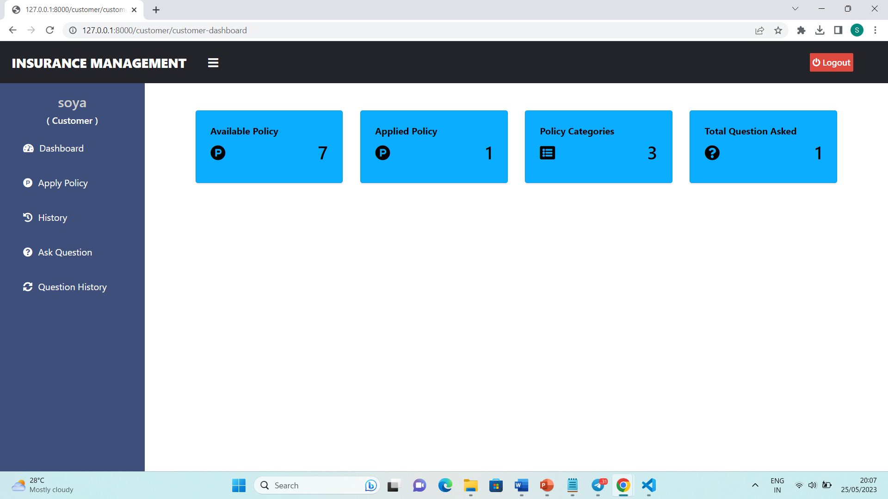
This is the homepage of a newly logged in users. The user will able to apply for policy and know about the available policies.

Slide 12
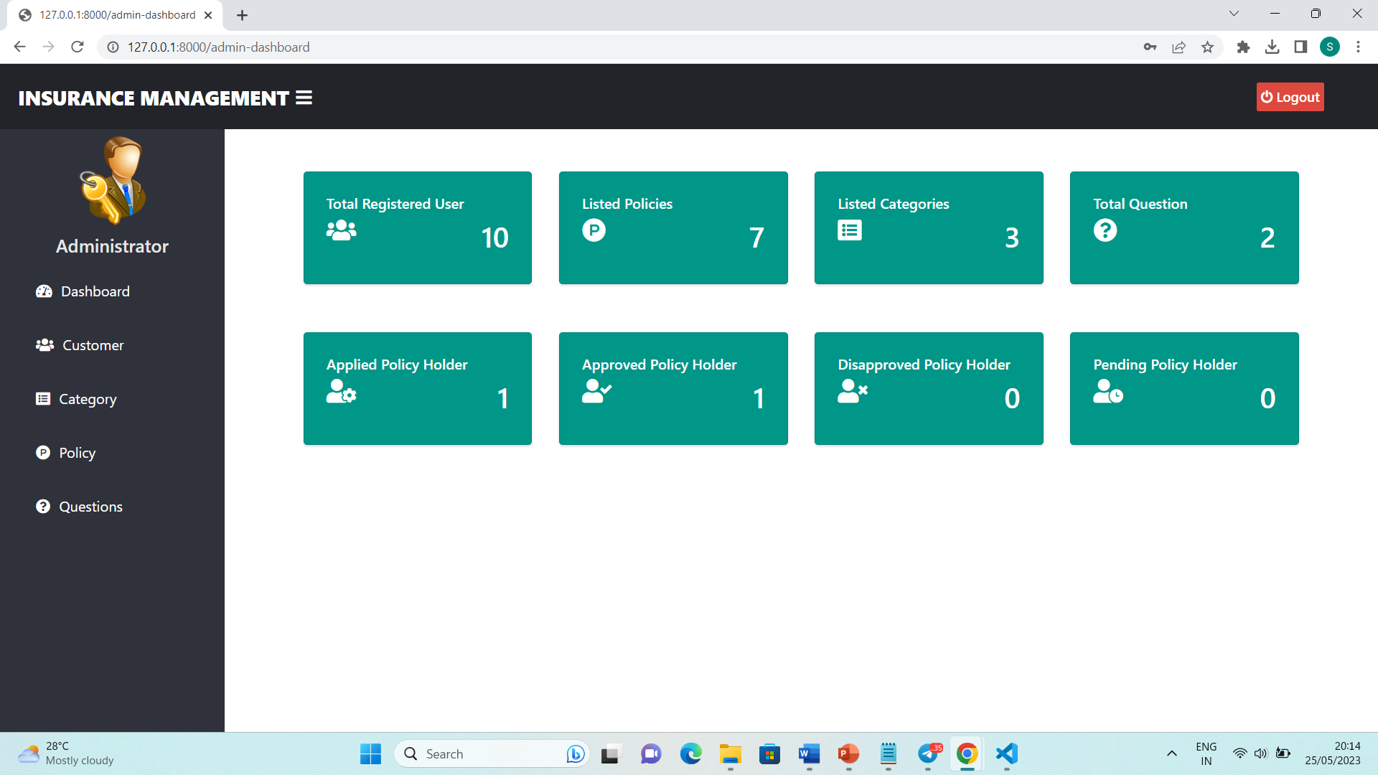
This is the admin page where the admin can see the total registered users, listed policies, approved policy holders, total questions

Slide 13

FUTURE ENHANCEMENTS
Policy Renewals and Reminders: Implement a feature that reminds users when their policies are due for renewal. Users can receive notifications and have the option to renew policies directly from the system. This feature can help improve customer retention and streamline the renewal process.
Policy Document Management: Allow users to access and download policy documents, such as terms and conditions, coverage details, and policy certificates. Implement a secure document repository and provide a user-friendly interface for document management.

Slide 14



CONCLUSION
The insurance management system project demonstrated successful implementation and addressed the identified requirements. It showcased effectively managing insurance policies, user interactions, and administrative tasks. The project review highlights the accomplishments achieved, while also acknowledging the potential for future enhancements to further enhance the system's capabilities.

Slide 15
REFERENCES
https://docs.djangoproject.com/
https://themewagon.github.io/insure/service.html
https://www.bootstrapdash.com/product/royalui
https://demos.wrappixel.com/free-admin-templates/bootstrap/ample-bootstrap-free/landingpage/index.html

